Slide 1
DAB 401GROUP PROJECT
Topic: Sentiment analysis for stock price prediction using natural language processing

Slide 2
GROUP MEMBERS
Bency Eldho (ID:0731915)
Mehak Rajdev (ID: 0732638)
Nanbal Akila Fompun (ID: 0714107)
Darin Amichandwala (0734860)
Dongmei Mo (0733239)
Sourav Thakur (0733904)

Slide 3
INTRODUCTION
In recent times we have come to discover that information outlets such as news headlines and social media outlets have come to determine the movement of stock prices.
The need to automate this process became increasingly pressing as lots of man hours are spent trying to predict stock prices.
The goal of this project is to apply machine learning techniques particularly Natural Language processing to predict the movement of stock prices.

Slide 4
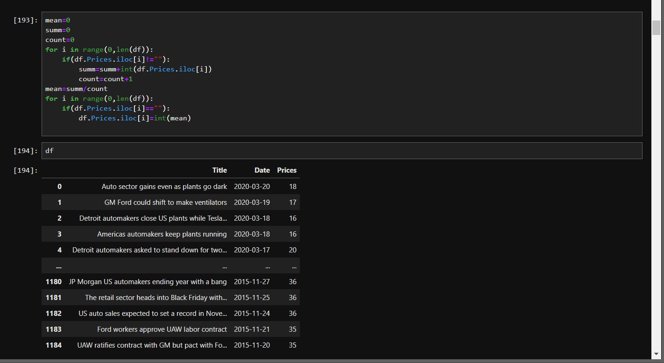
DATA SOURCES
Our data sources are seekingalpha.com and Yahoo Finance where we obtained headline data and stock price data merging the two datasets into one dataset.
We merged our data from both sources and performed some imputation using the mean method where there were missing values

Slide 5
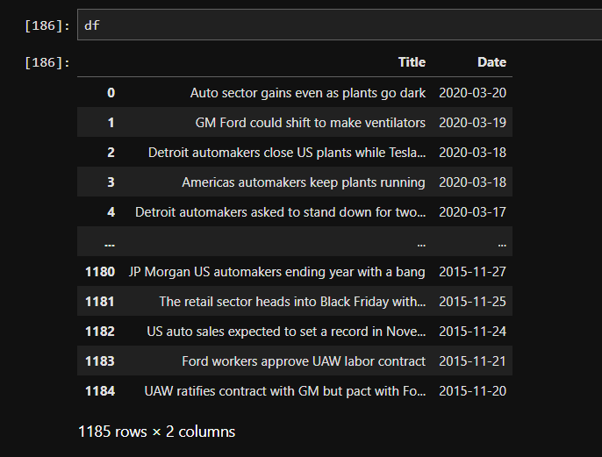
DATA SOURCES
The final merged dataset consists of 1185 rows and 3 columns named Title, Date and Price.

Slide 6
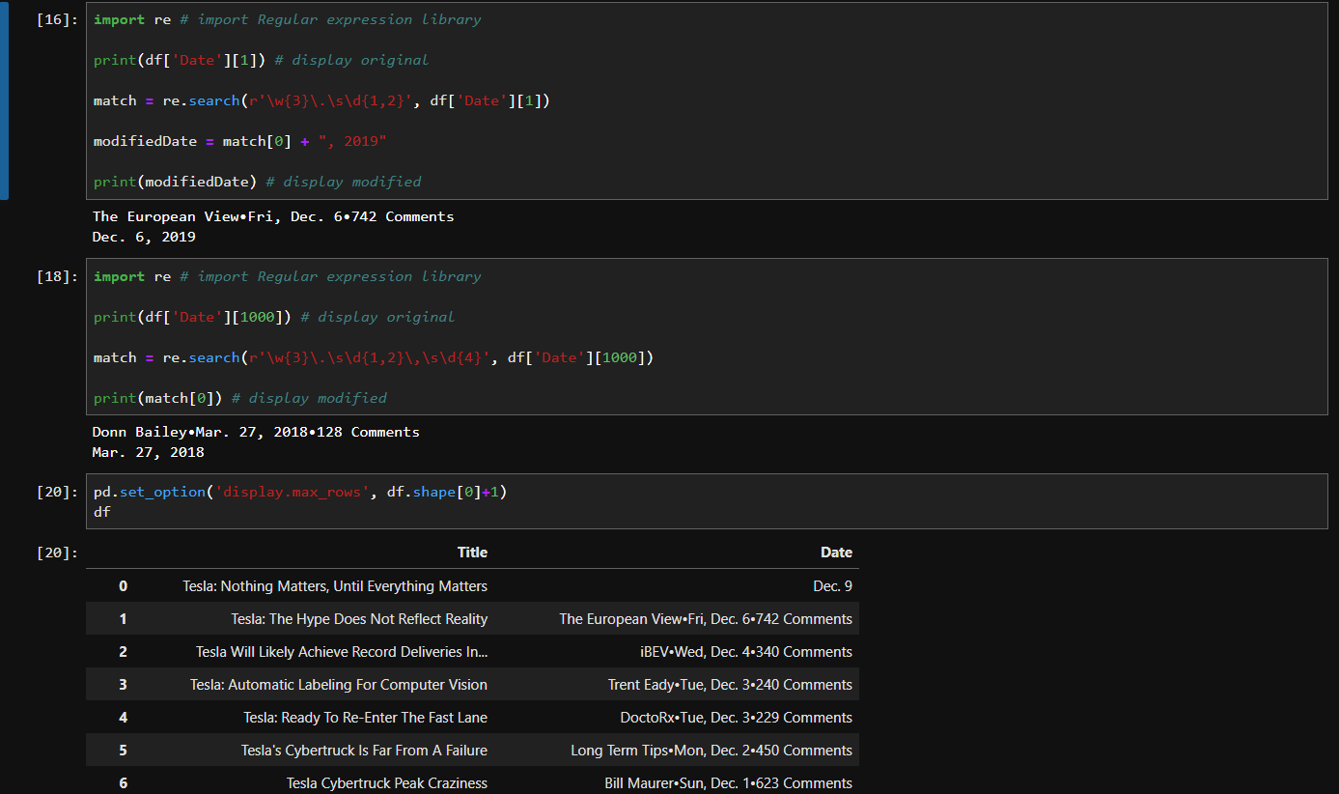
DATA CLEANING
Removal of special characters from text data using the Regular expression library in python.

Slide 7
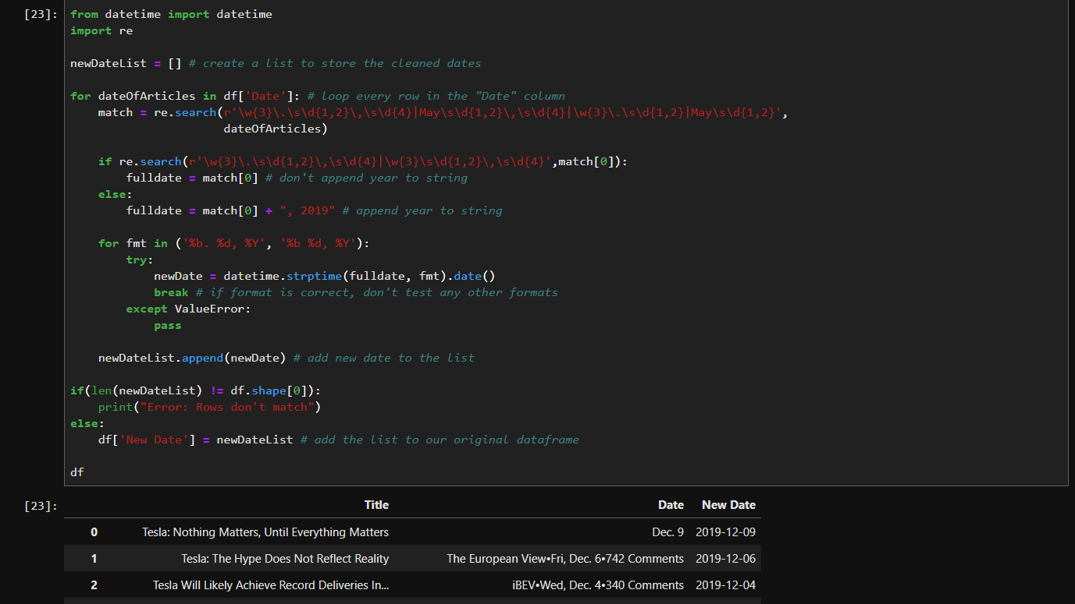
DATA CLEANING
Creating a new column for date using the datetime library in python.

Slide 8
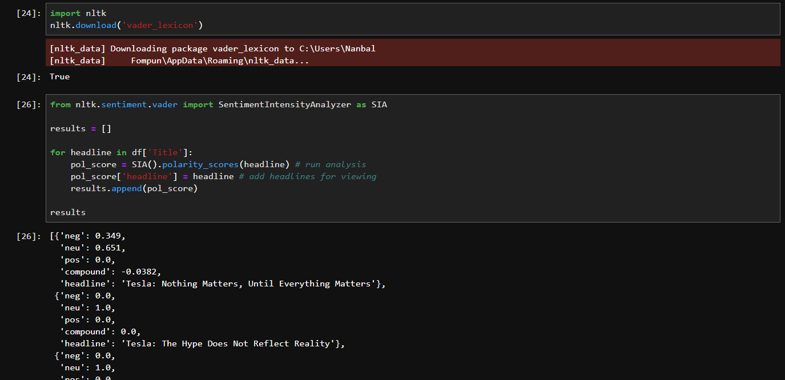
EXPLORATORY DATA ANALYSIS
Here we calculated the polarity scores of each sentiment with the Sentiment Intensity Analyzer (SIA) in python which assigns a score to each sentiments and calculates a compound.

Slide 9
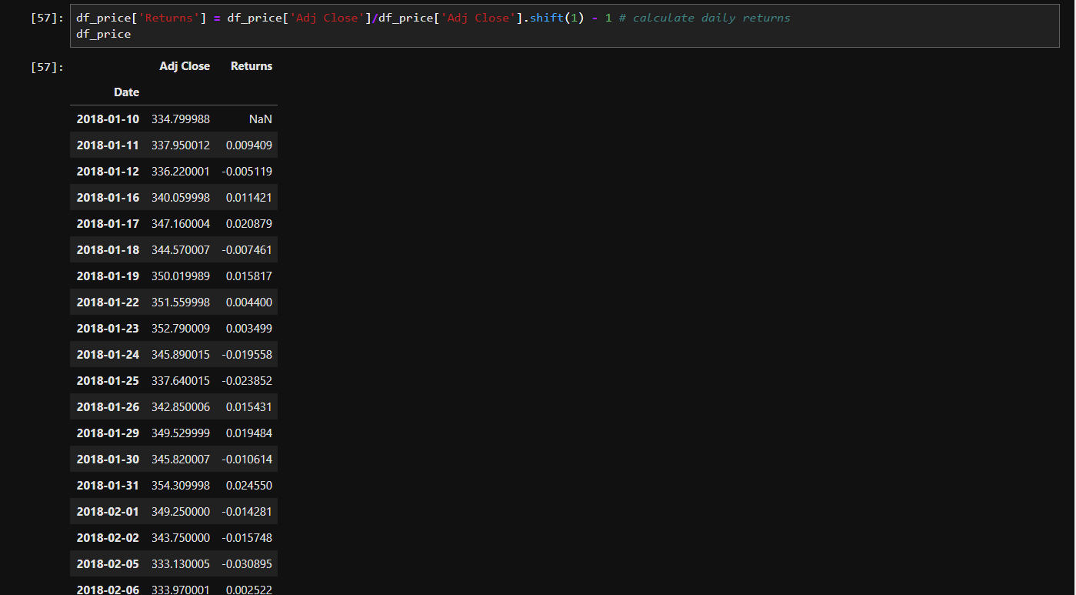
EXPLORATORY DATA ANALYSIS
Calculated daily returns and merge with the closing rice column in a new dataframe.

Slide 10
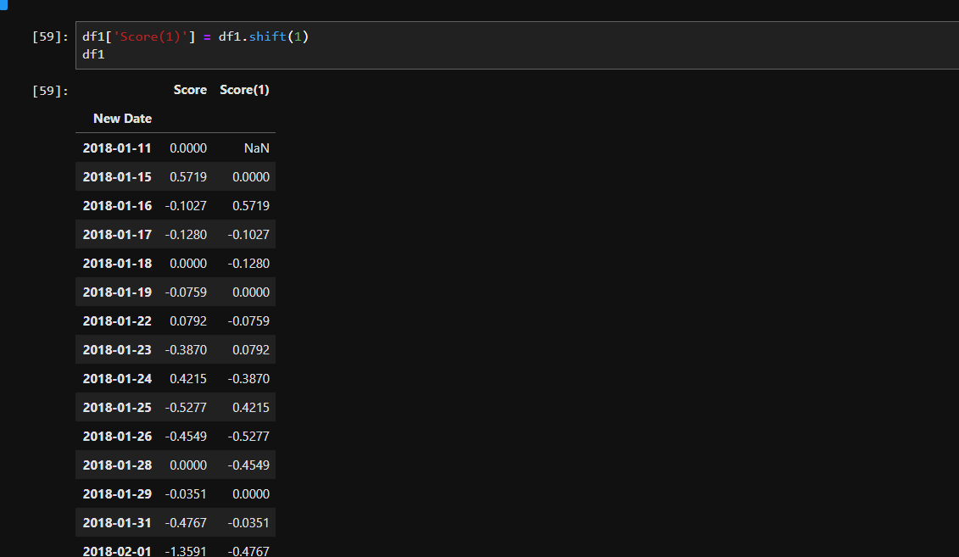
EXPLORATORY DATA ANALYSIS
We created a new column for score by shifting by one since we want to predict stock price movements for the next day.

Slide 11
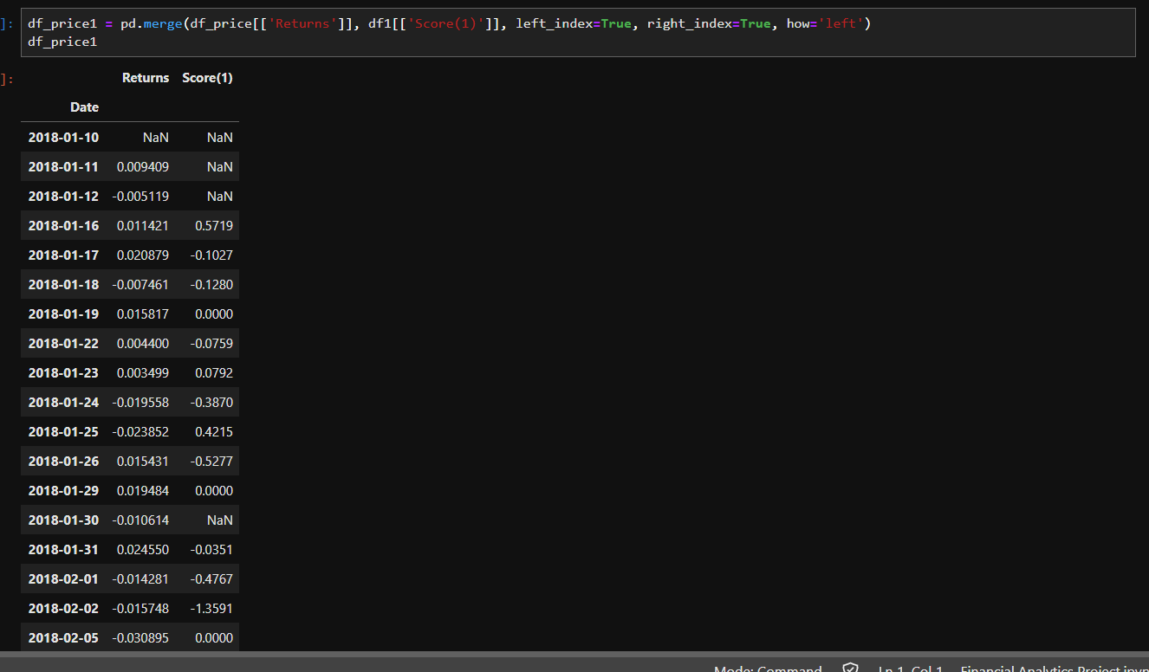
EXPLORATORY DATA ANALYSIS
We merged the new Date, Score and the Returns column.

Slide 12
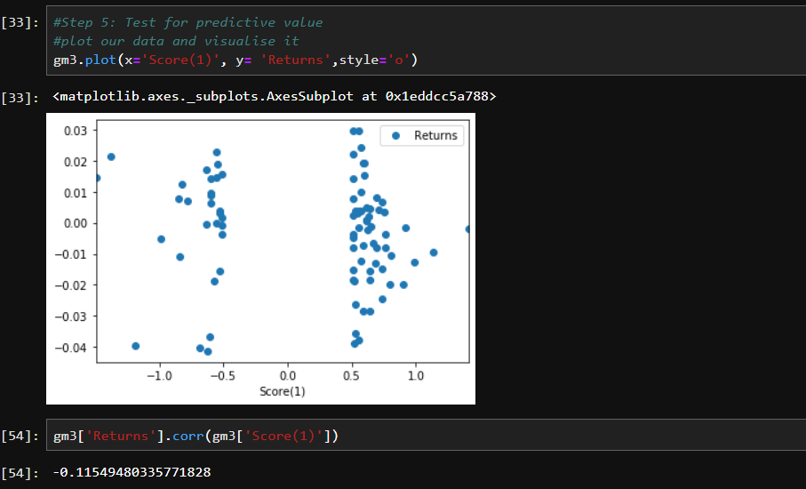
EXPLORATORY DATA ANALYSIS
We carried out a correlation analysis between the Returns and the Score column and discovered we had a weak negative score of 0.1154which suggests that we are not likely to get high accuracy if we build a model based on the data and the correlation is inverse.

Slide 13
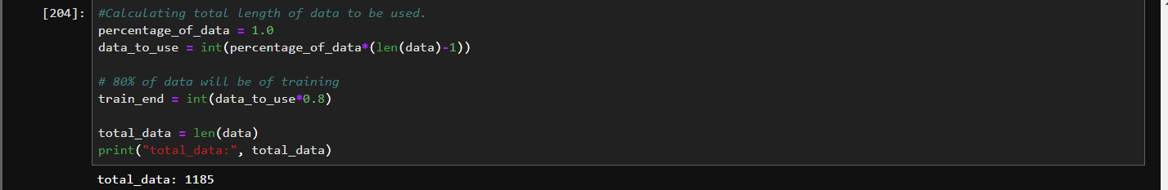
DATA PREPROCESSING
Calculating the total percentage of data to use for the building of model.

Slide 14
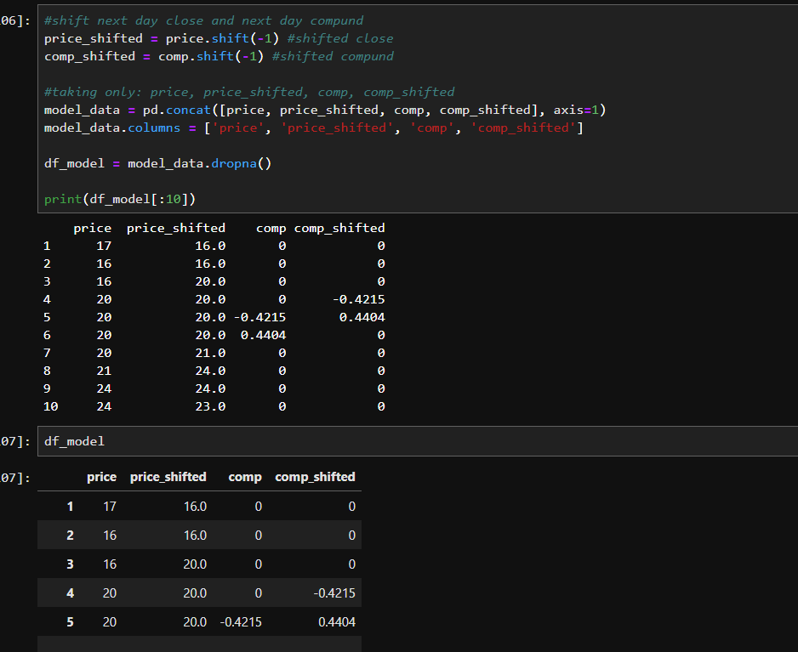
DATA PREPROCESSING
Shifted the price and compound columns by one and storing them as new columns in the dataframe as we are trying to predict for the next day.

Slide 15
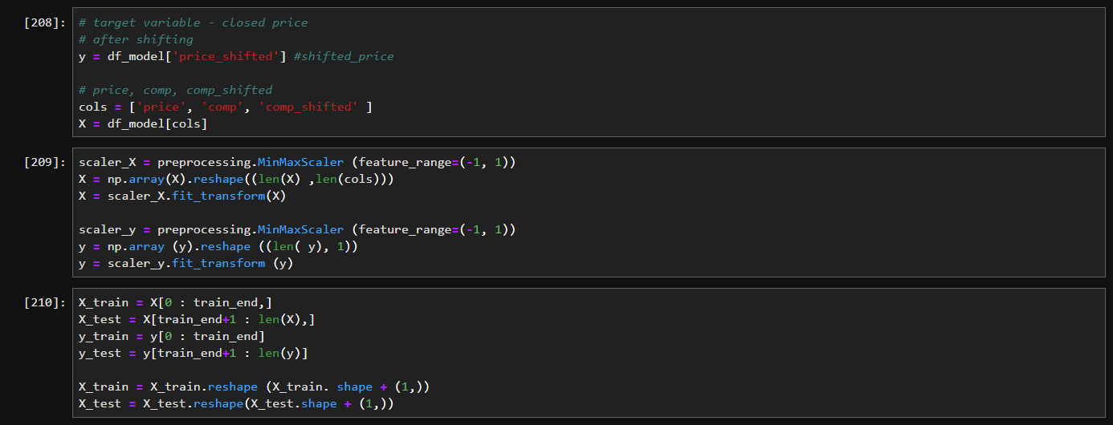
DATA PREPROCESSING
We separated our data into target and feature with price_shifted column being the target (y) and the price, comp and comp_shifted the feature variables (X).
We proceeded to scale our data using the MinMax scaler
We split our data into training and test sets.

Slide 16
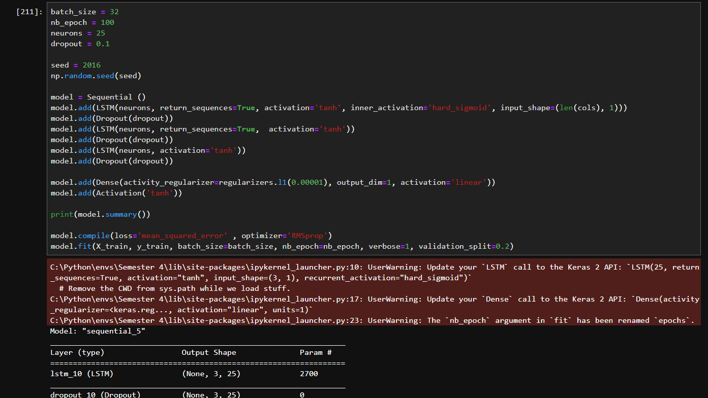
MODEL BUIDLING
We inititaed and trained our recurrent neural network (LSTM) with the parameters shown in preparation to be applied to our data.

Slide 17
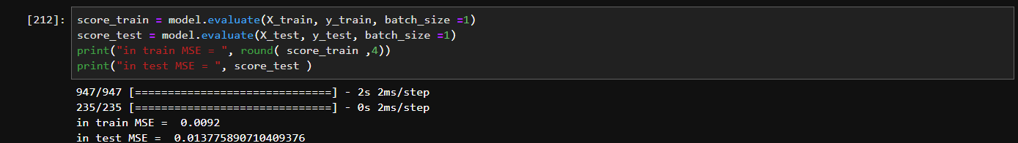
MODEL BUIDLING AND EVALUATION
We evaluated our model on the training and test sets using Mean Sqaured Error (MSE) as our evaluation metrics. We got a score of 0.0092 o the training set 0.0137 on the test sets a good indication that our model was able to predict with high accuracy.

Slide 18
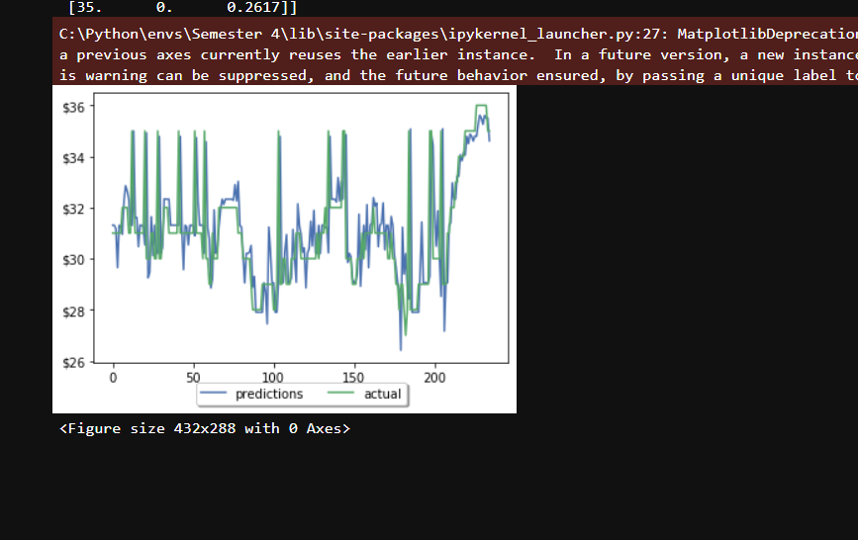
MODEL BUIDLING AND EVALUATION
This visualization confirms that the model we implemented has a high accuracy and could be relyed upon.

Slide 19
CONCLUSION
In this project we have been able to establish that Natural Language Processing is a useful and powerful tool in the prediction of stock price movements and eases the burden of wasting man hours.
Recurrent Neural Networks particularly LSTM provide high accuracy as shown by the evaluation metric we used (MSE) and the visualization of our results.

Slide 20
THANK YOU FOR LISTENING!

